Slide 1
Image Approximation via Semi-Transparent Shape Evolution
Matteo Liotta
SM3800072
Optimization for Artificial Intelligence, 2025, UniTS - Final Project

Slide 2
Problem Introduction

Slide 3

Problem Introduction
This project is a revisit of the “Genetic-lisa” Peter Braden’s project, which aims to recreate images with genetic algorithms.
It had different implementations over time, from Python to C
The base concept is to evolve a series of overlapping shapes to reach a certain level of similitude with the original picture.
Introduction | Individuals | Ev. Cycle | Crossover | Mutation | Final Improvements | Results
Notes:
Revisit
The idea is to define our images as

Slide 4
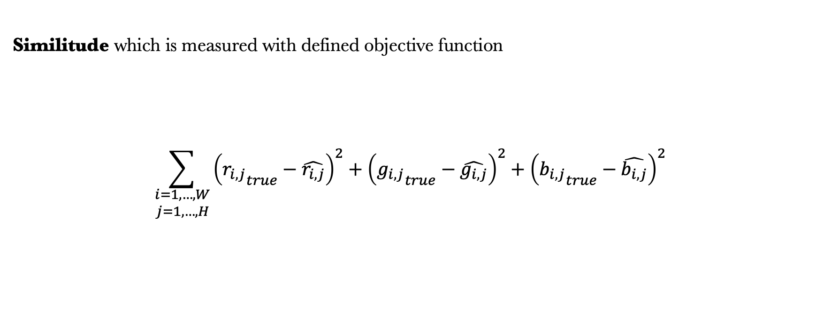
Problem Introduction
Similitude which is measured with defined objective function
$$\sum_{\begin{matrix}i=1,…,W \\ j=1,…,H\end{matrix}}{{\left({r_{i,j}}_{true}−\hat{r_{i,j}}\right)}^{2}+{\left({g_{i,j}}_{true}−\hat{g_{i,j}}\right)}^{2}+{\left({b_{i,j}}_{true}−\hat{b_{i,j}}\right)}^{2}}$$
Introduction | Individuals | Ev. Cycle | Crossover | Mutation | Final Improvements | Results
Notes:
Where the similutde

Slide 5
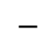
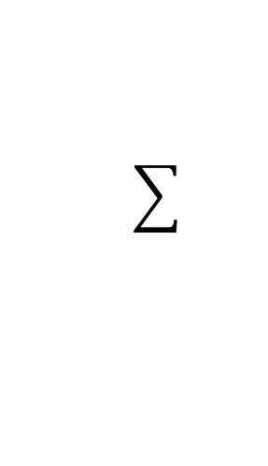
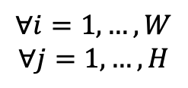
Problem Introduction
Similitude which is measured with defined objective function
(
)
2
$$∀i=1,…,W$$
$$∀j=1,…, H$$
$$−$$
Reference
Evol. Image
( i,j )
Introduction | Individuals | Ev. Cycle | Crossover | Mutation | Final Improvements | Results

Slide 6
How are individuals defined?

Slide 7
How are individuals defined?
Shapes
Color

Slide 8
How are individuals defined?
Shape Definition
In the original code different shapes are proposed, but here we can focus on
Ellipses
Rectangle
Triangles
defined as a dictionary of name and coordinates genetated at random
{'type': 'triangle', 'coords': [44, 213, 93, 148, 163, 220]}
Introduction | Individuals | Ev. Cycle | Crossover | Mutation | Final Improvements | Results

Slide 9
Shape Geometry Definition
{'type': 'triangle', 'coords': [44, 213, 93, 148, 163, 220]}
(x,y)
(x,y)
(x,y)
y
y + shape height
{'type': 'rectangle', 'coords': [31, 136, 48, 160]}
{'type': ‘ellipse', 'coords': [31, 136, 48, 160]}
x
x + shape width
Introduction | Individuals | Ev. Cycle | Crossover | Mutation | Final Improvements | Results
Notes:
Coordinates dependent on shape

Slide 10
Shape Color Definition
Also color (A,R,G,B) tuples are generated at random
def generate_color(prev = None, a_mutation = (-0x5,0x3), rgb_mutation = (-0x5,0x3)):
if prev:
return (prev[0] + random.randint(*a_mutation), # R
prev[1] + random.randint(*rgb_mutation), # G
prev[2] + random.randint(*rgb_mutation), # B
prev[3] + random.randint(*rgb_mutation)) # A
return (random.randint(0x33, 0x99), # R
random.randint(0, 0xff), # G: between 0 and 255
random.randint(0, 0xff), # B: between 0 and 255
random.randint(0, 0xff)) # A: between 0 and 255
We’ll see this later…
Introduction | Individuals | Ev. Cycle | Crossover | Mutation | Final Improvements | Results
Notes:
Add a random noise to the original tuple

Slide 11
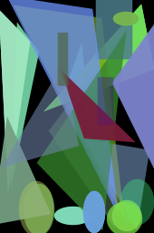
Individuals
Name | Dna | Fitness value
String | {shapes: {type, coordinates}, colors : color tuple} | Scalar
Introduction | Individuals | Ev. Cycle | Crossover | Mutation | Final Improvements | Results
Notes:
All these informations are encorded into the individual DNA: list of genes where each gene is a dictionary of shape (type + coords) & color
This leads to the phenotype (used in the loss) where shapes are represented on a canvas

Slide 12
Evolutionary cycle
* By original proposed code

Slide 13
Evolutionary cycle
Population Initialization
Notes:
Of 5

Slide 14
Population Initialization
Parents
Crossover
Additional 10 individuals
Notes:
Crossover makes we end up with 10 new individuals

Slide 15
Population Initialization
Parents
Crossover
Mutation
Additional 10 individuals
Of the 10 additional individuals
Notes:
Which are later mutated

Slide 16
Population Initialization
Parents
Crossover
Mutation
Selection
Additional 10 individuals
Of the 10 additional individuals
Select 5 over 15
Notes:
NEW INDIVIDUALS added in the population We select the best 5 based on the objective function results (ranked selection)

Slide 17
For fixed number of times
Population Initialization
Parents
Crossover
Mutation
Selection
Additional 10 individuals
Of the 10 additional individuals
Select 5 over 15
Notes:
Cycle restarts until #epochs found.

Slide 18
How is crossover defined?

Slide 19
Individual Recap
Each individual has its own Dna, defined of atomic units: the genes
i-th gene
Introduction | Individuals | Ev. Cycle | Crossover | Mutation | Final Improvements | Results

Slide 20
Individual Recap
i-th gene
Shape type and
coordinates
Shape color
Introduction | Individuals | Ev. Cycle | Crossover | Mutation | Final Improvements | Results

Slide 21
Individual Recap
Individual dna
Introduction | Individuals | Ev. Cycle | Crossover | Mutation | Final Improvements | Results

Slide 22
How is crossover defined?
We start with a parent population
Parent 1
Parent 2
Parent 3
Introduction | Individuals | Ev. Cycle | Crossover | Mutation | Final Improvements | Results

Slide 23
How is crossover defined?
To generate a new individual we select randomly a parent dna and deepcopy it.
Parent 1
Parent 2
Parent 3
Introduction | Individuals | Ev. Cycle | Crossover | Mutation | Final Improvements | Results

Slide 24
How is crossover defined?
Then iterate on parents: change one random gene of in place of another of this offspring
Introduction | Individuals | Ev. Cycle | Crossover | Mutation | Final Improvements | Results

Slide 25
How is crossover defined?
Parent 1
Parent 2
Parent 3
Introduction | Individuals | Ev. Cycle | Crossover | Mutation | Final Improvements | Results

Slide 26
How is crossover defined?
Parent 1
Parent 2
Parent 3
Introduction | Individuals | Ev. Cycle | Crossover | Mutation | Final Improvements | Results

Slide 27
How is crossover defined?
Parent 1
Parent 2
Parent 3
Introduction | Individuals | Ev. Cycle | Crossover | Mutation | Final Improvements | Results

Slide 28
How is crossover defined?
Parent 1
Parent 2
Parent 3
Introduction | Individuals | Ev. Cycle | Crossover | Mutation | Final Improvements | Results

Slide 29
How is crossover defined?
Parent 1
Parent 2
Parent 3
Introduction | Individuals | Ev. Cycle | Crossover | Mutation | Final Improvements | Results

Slide 30
How is crossover defined?
Parent 1
Parent 2
Parent 3
Introduction | Individuals | Ev. Cycle | Crossover | Mutation | Final Improvements | Results

Slide 31
How is crossover defined?
After that, mutation will occur to each new offspring.
Introduction | Individuals | Ev. Cycle | Crossover | Mutation | Final Improvements | Results

Slide 32
How is mutation defined?

Slide 33
Individuals
Three different actions:
New random shape appending to offsprings DNA
Shape change and color change of a gene
Random shape removal to offspring DNA
But… the change function can now handle a new feature: we can change not by deletion and random reinsertion of a gene, but deletion and conditionate re-generation.
len<500 and 25% probability
elif 75% probability
else
Introduction | Individuals | Ev. Cycle | Crossover | Mutation | Final Improvements | Results
Notes:
Shorter than 500:
25 % -> adding
75 % -> change
Longer than 500:
75 % -> change
25 % -> removal

Slide 34
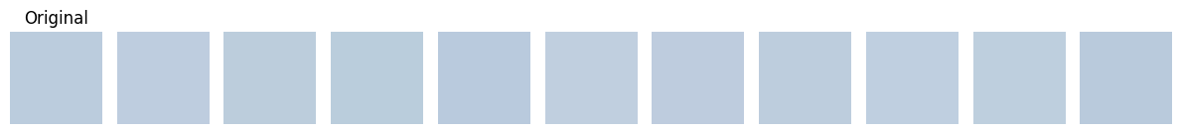
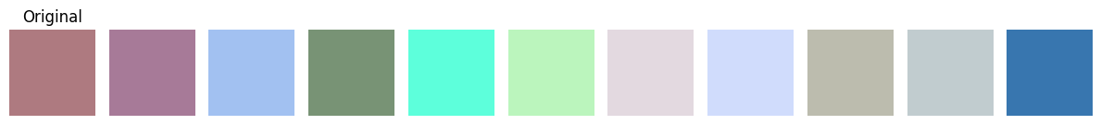
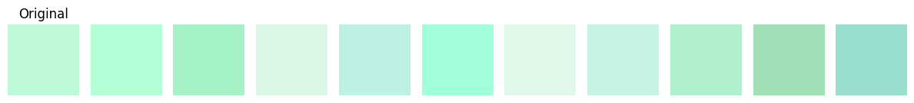
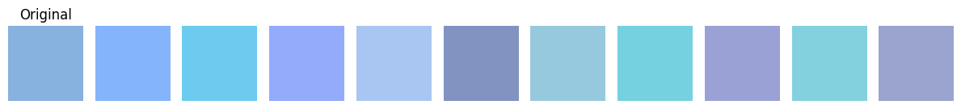
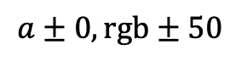
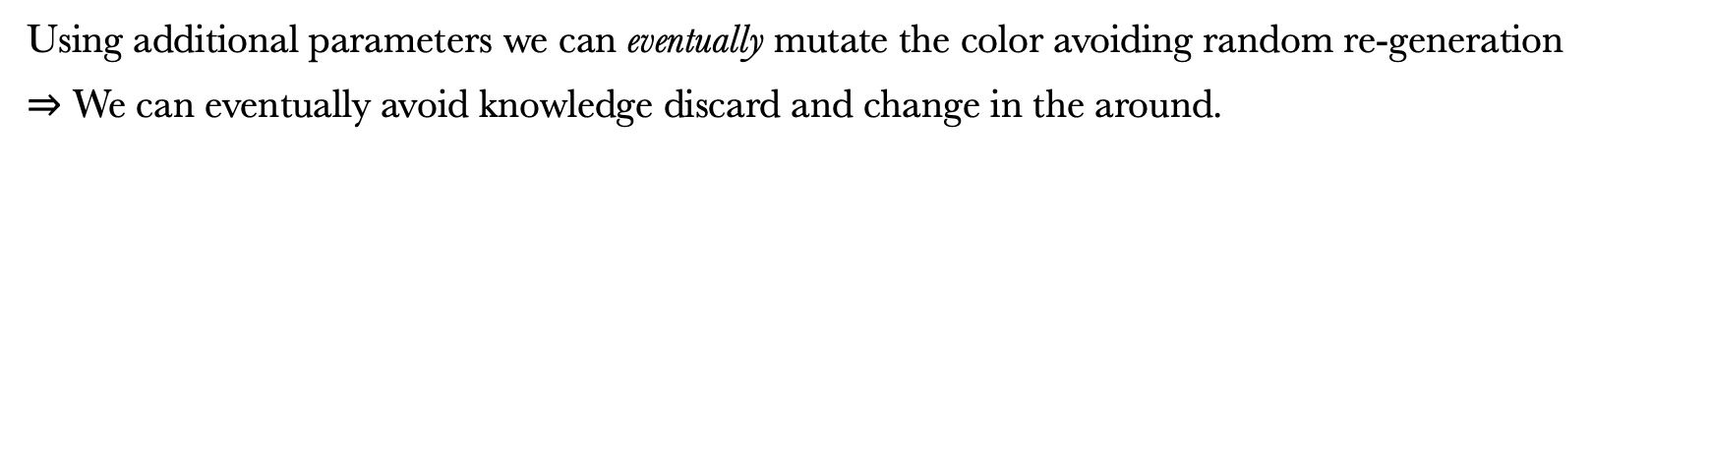
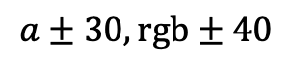
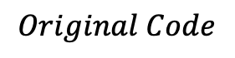
Shape Color “Prev” Modification
Using additional parameters we can eventually mutate the color avoiding random re-generation
$⇒$ We can eventually avoid knowledge discard and change in the around.
$$Original Code$$
$$a±0,rgb±50$$
$$a±30,rgb±40$$
Introduction | Individuals | Ev. Cycle | Crossover | Mutation | Final Improvements | Results
Notes:
… But here additional range parameters has been introduced for better mutation performances

Slide 35


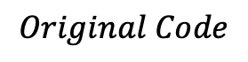
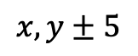
…Back to shape definition
This idea could be introduced in shape mutation too: it could avoid, eventually, random shape re-generation
$$Original Code$$
$$x,y±5$$
Introduction | Individuals | Ev. Cycle | Crossover | Mutation | Final Improvements | Results
Notes:
This idea can be proposed inside the shape definition function, since in this way shapes under change in mutation… can be modified instead of deleted and randomly substituted

Slide 36


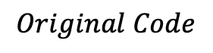
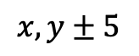
…Back to shape definition
This idea could be introduced in shape mutation too: it could avoid, eventually, random shape re-generation
$$Original Code$$
$$x,y±5$$
Introduction | Individuals | Ev. Cycle | Crossover | Mutation | Final Improvements | Results

Slide 37


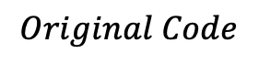
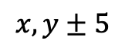
…Back to shape definition
This idea could be introduced in shape mutation too: it could avoid, eventually, random shape re-generation
$$Original Code$$
$$x,y±5$$
Introduction | Individuals | Ev. Cycle | Crossover | Mutation | Final Improvements | Results

Slide 38
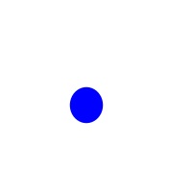

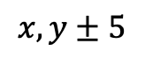
…Back to shape definition
This idea could be introduced in shape mutation too: it could avoid, eventually, random shape re-generation
$$Original Code$$
$$x,y±5$$
Introduction | Individuals | Ev. Cycle | Crossover | Mutation | Final Improvements | Results

Slide 39
(modified*) Original way: performances and results
* ellipses, rectangles and triangles and shape mutation changed

Slide 40
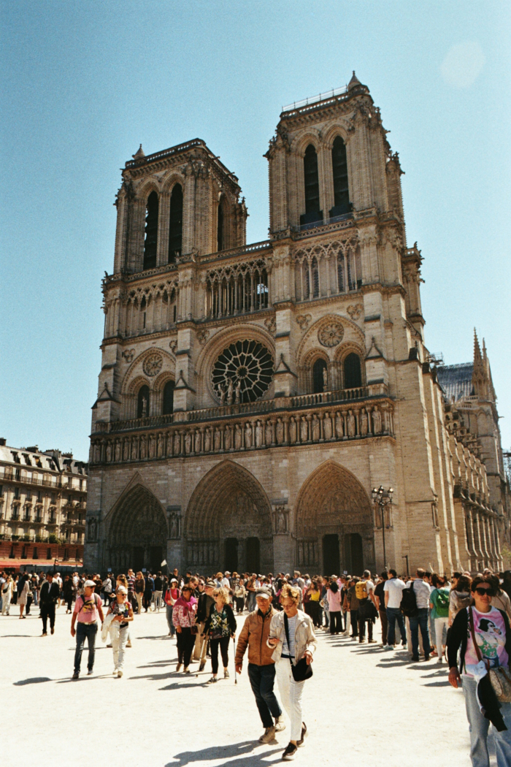
Example on Notre Dame
The example picture is a Notre Dame colored image I took this year in Paris.
The population initial parameters were
Image_size: 170 x 256
Generation_population: 10
Crossover_population: 5
Over 30000 epochs.
Introduction | Individuals | Ev. Cycle | Crossover | Mutation | Final Improvements | Results

Slide 41
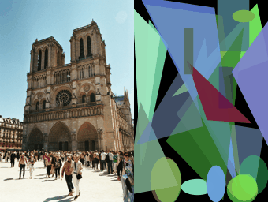
Introduction | Individuals | Ev. Cycle | Crossover | Mutation | Final Improvements | Results

Slide 42
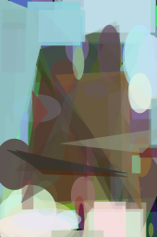
The result isn’t so good:
Big shapes
Computational time is the main problem: 1h30m for 30000 epochs
Lack in precision
Why don’t we change the approach?
Introduction | Individuals | Ev. Cycle | Crossover | Mutation | Final Improvements | Results

Slide 43
How can we speed up evolution?

Slide 44
How can we speed up evolution?
Multiprocessing patches
evolution
Fitness simplification
Notes:
The main idea in improving the original code is take advantage of multi processing

Slide 45
Patches idea introduction
The main idea is to take advantage of multi-processing.
Notice this is related to the number of cores available
Also considering our constraints…
The original reference should be big enough
We cannot evolve the entire original image on different nodes
So the idea is to break and cut the image… into smaller pieces
Introduction | Individuals | Ev. Cycle | Crossover | Mutation | Final Improvements | Results

Slide 46
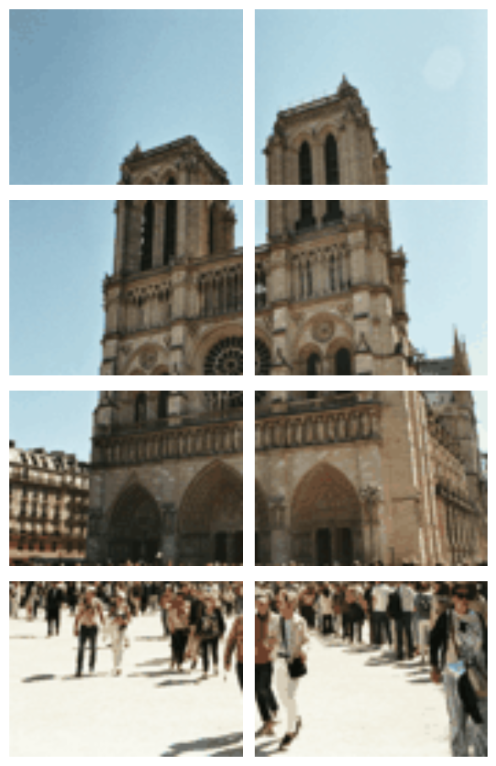
Patches idea introduction
#processes=8
Introduction | Individuals | Ev. Cycle | Crossover | Mutation | Final Improvements | Results

Slide 47
Patches idea introduction
… and evolve independently each piece.
We would have many advantages:
Each core could handle evolution independently on a sub part of the image (patch)
Since shape sizes are canvas related, more precision should be present
We should notice a speed increase since fitness evaluations would be on smaller images, proportional to the number of cores
Over same number of epochs we end up with core-number times more shapes
No assumptions or reduced set of shapes and colors
+ Now we can measure shape sizes with a parameter
Introduction | Individuals | Ev. Cycle | Crossover | Mutation | Final Improvements | Results

Slide 48
Fitness function revisited
+ we can define an alternative fitness which is the L1 norm:
def fitness(self):
return self._fitness or self._fitness_func()
def _fitness_func(self):
ref_img = self.reference_image.convert("RGBA")
draw_img = np.array(self.draw().convert("RGBA"), dtype=np.int16)
ref_img = np.array(ref_img, dtype=np.int16)
diff = draw_img[:, :, :3] - ref_img[:, :, :3]
fitness = np.sum(np.abs(diff))
self._fitness = fitness
return fitness
Introduction | Individuals | Ev. Cycle | Crossover | Mutation | Final Improvements | Results

Slide 49
Modified way: (compared) performances and results

Slide 50
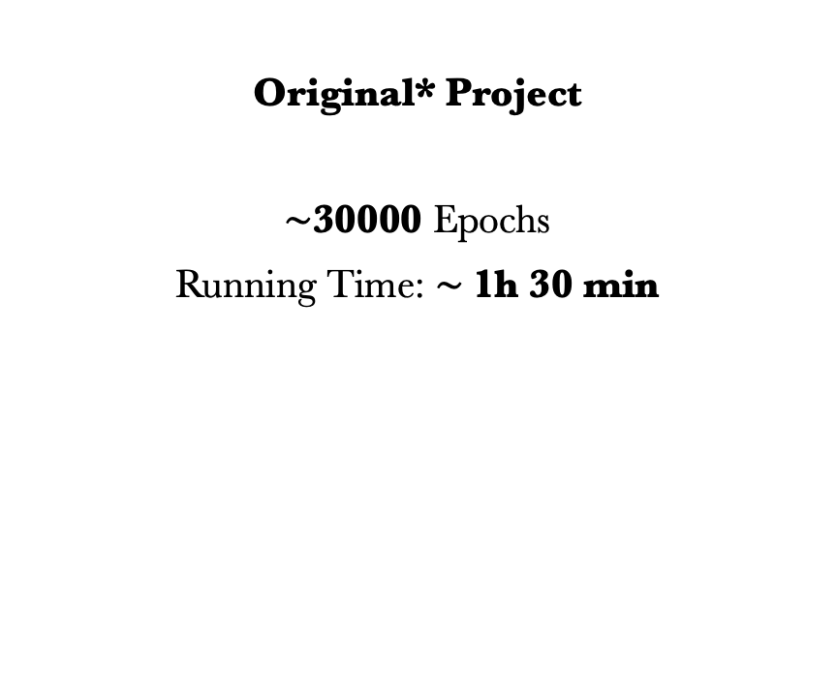
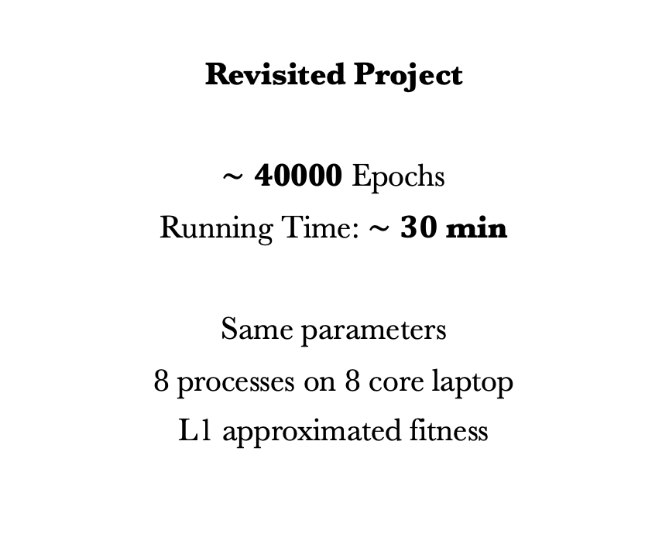
Time comparison
Original* Project
$∼$30000 Epochs
Running Time: $∼$1h 30 min
Revisited Project
$∼4$0000 Epochs
Running Time: $∼30$ min
Same parameters
8 processes on 8 core laptop
L1 approximated fitness
Introduction | Individuals | Ev. Cycle | Crossover | Mutation | Final Improvements | Results

Slide 51
Time comparison
Original*
Reference
Revisited
Introduction | Individuals | Ev. Cycle | Crossover | Mutation | Final Improvements | Results

Slide 52
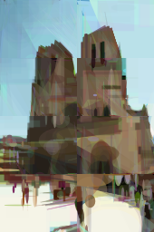
Time comparison
Original*
Reference
Revisited
Introduction | Individuals | Ev. Cycle | Crossover | Mutation | Final Improvements | Results

Slide 53
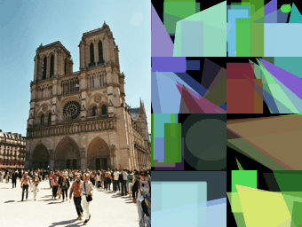
Introduction | Individuals | Ev. Cycle | Crossover | Mutation | Final Improvements | Results
Notes:
We can see many of previous problems to be solved

Slide 54
Can we do something more?

Slide 55
Can we do something more?
Shape size reduction
ratio*
* w.r.t. image size
Introduction | Individuals | Ev. Cycle | Crossover | Mutation | Final Improvements | Results
Notes:
Because we need more precision that intuitively is shape size dipendent

Slide 56
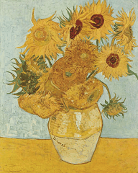
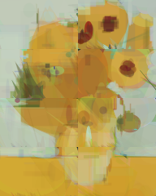
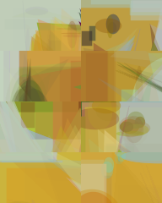
Reference
Small Shapes Evolution
1000 epochs
Big Shapes Evolution
1000 epochs
Introduction | Individuals | Ev. Cycle | Crossover | Mutation | Final Improvements | Results
Notes:
This is a final consideration

Slide 57
We see a great improvement with a higher shape size reduction rate on fixed same conditions
Small Shapes
Big Shapes
Introduction | Individuals | Ev. Cycle | Crossover | Mutation | Final Improvements | Results
Notes:
* The size is proportional to patch reference size

Slide 58
We can finally see results with:
Patches and multiprocessing introduction
More efficient fitness
Random re-generation avoidance for shapes and colors
Better shape random generation
Shape size ratio introduction

Slide 59

Time comparison
Reference
Small Shapes Evolution
50000 epochs

Slide 60
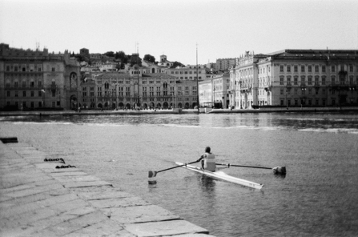
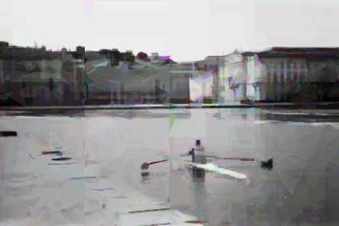
Time comparison
Reference
Small Shapes Evolution
50000 epochs
Notes:
Curious about B/W

Slide 61
Conclusion on Notre Dame visual comparison

Slide 62
Time comparison
Original*
Reference
Revisited
Small shape revisited
Notes:
Evolution over 30000 and 50000 epochs

Slide 63
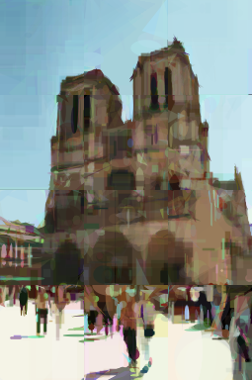
Time comparison
Original*
Reference
Revisited
Small shape revisited
Notes:
Evolution over 30000 and 50000 epochs

Slide 64
Project References
[1] The evolution of a Smile, Peter Braden: https://github.com/peterbraden/genetic-lisa/
[2] Mona Lisa Gif Evolution: https://github.com/peterbraden/genetic-lisa/blob/master/images/lisa-anim.gif
[3] Vase with Twelve Sunflowers (Arles, August 1888), Van Gogh. Neue Pinakothek, Munich: https://commons.wikimedia.org/wiki/File:Vincent_Willem_van_Gogh_128.jpg
[4] La persistenza della memoria, Dalì: https://www.analisidellopera.it/wp-content/uploads/2018/10/Dali_La_persistenza_della_memoria-1.jpg

